Slide 1
Eclipse Developer Demographic Profile
Information Source
Company: Genuitec LLC
Product : MyEclispe Enterprise Workbench
- 160,000 Members
- 136 Countries
- > 500,000 Downloads
- 36 Months

Slide 2
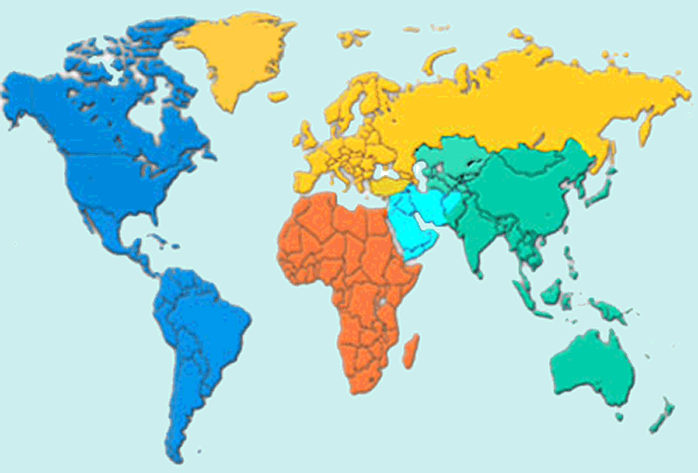
Eclipse Developer Demographic Profile
Active Users
Germany – 7.4%
UK – 3.7%
France - 3.1%
EMEA
32%
North America
37%
Canada
4.2%
USA
32%
APAC
24.4%
ME
0.2%
China – 9.7%
India – 5.4%
Japan –1.5%
Australia - 1.6%
Brazil
3.7%
Africa
1.4%
South America
5%
South Africa
0.5%

Slide 3
Eclipse Developer Demographic Profile
Active Markets
Germany – 8.8%
UK – 6%
France - 2%
EMEA
31%
North America
61%
Canada
4.7%
APAC
5.9%
USA
56%
ME
0.04%
China – 0.1%
India – 1.5%
Japan –1.5%
Australia - 2.4%
Brazil
0.7%
Africa
0.9%
South America
1%
South Africa
0.5%

Slide 4
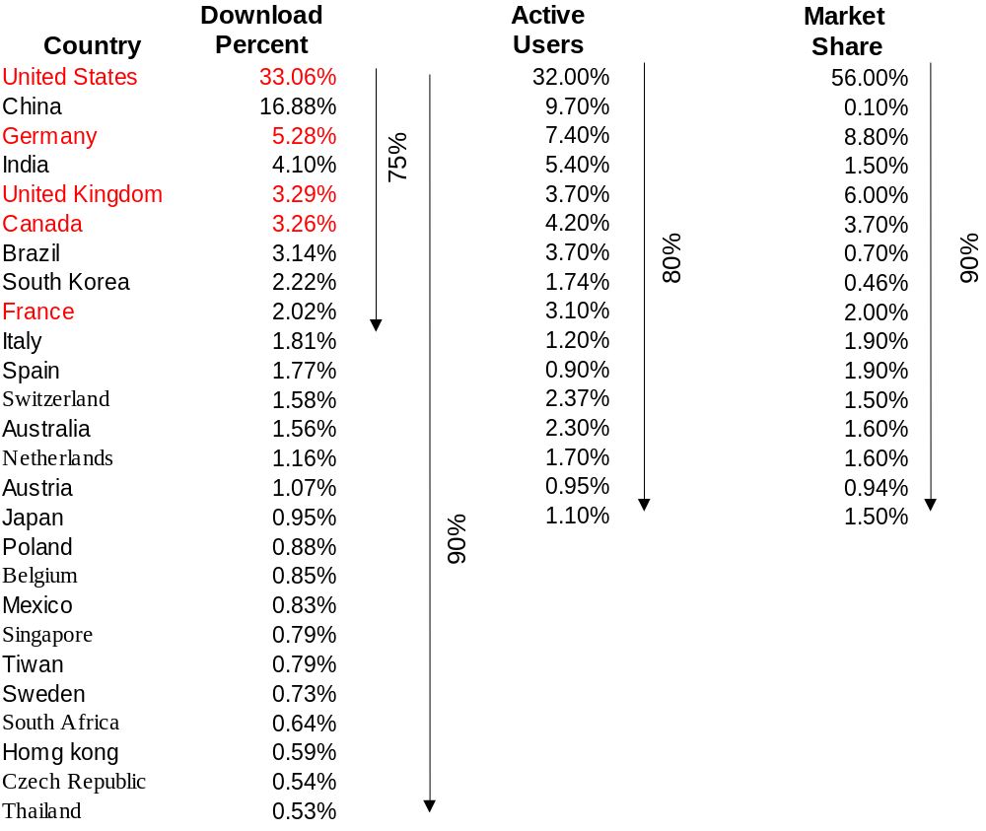
Eclipse Developer Demographic Profile
Profile Summary

